Slide 1

Eco sense : Smart air quality monitoring dashboard
DSA0613-Data Handling and Visualization for Data Analytics
Presented by:
A. Pavithra (192424347)
C. H. Harshitha (192473031)
P. Aufrin (192473029)
Guided by:
Dr. Kumaragurubaran T
Dr. Senthilvadivu S

Slide 2
Abstract
Eco Sence is a smart air quality monitoring dashboard designed to collect and visualize real-time environmental pollution data. It integrates sensor inputs and data analytics to provide a clear overview of air quality and pollutant distribution. The system analyzes trends over time to identify patterns and relationships between different pollutants. These insights help understand seasonal variations and factors affecting environmental health. A geospatial module enables location-based monitoring with smart visualizations and predictive alerts. Overall, Eco Sence supports informed decision-making, environmental awareness, and healthier urban living.

Slide 3
Introduction
Air pollution is a growing environmental and health issue caused by urbanization and industrial activities.
Continuous air quality monitoring is necessary to understand pollutant levels and their effects.
Eco Sence is a smart dashboard designed to track and visualize real-time air quality data.
The system combines sensors, data analytics, and visualization for effective monitoring.
It promotes environmental awareness and supports better decisions for healthier living.

Slide 4
Problem Statement
Increasing air pollution levels are difficult to monitor consistently using traditional manual methods.
Lack of real-time air quality data makes it hard to understand pollutant distribution and severity.
Existing systems often fail to analyze trends and relationships between pollutants over time.
There is limited access to geospatial visualization for location-based air quality monitoring.
Absence of smart insights and predictive alerts reduces early warning capabilities.
A need exists for an integrated, user-friendly dashboard that provides accurate monitoring and actionable environmental insights.

Slide 5
Objectives
To develop a smart dashboard for real-time air quality monitoring.
To analyze and visualize pollutant distribution across monitored areas.
To identify trends and relationships between different air pollutants.
To implement geospatial mapping for location-based air quality insights.
To generate smart alerts and predictive environmental insights.
To promote environmental awareness and support data-driven decision-making.

Slide 6
Methodology
Collect real-time air quality data using sensors and reliable data sources.
Preprocess and clean the collected data for accurate analysis.
Analyze pollutant distribution and temporal trends using statistical techniques.
Apply correlation and pattern analysis to study relationships between pollutants.
Visualize data through dashboards and geospatial mapping tools.
Generate smart insights and alerts based on analyzed air quality patterns.

Slide 7
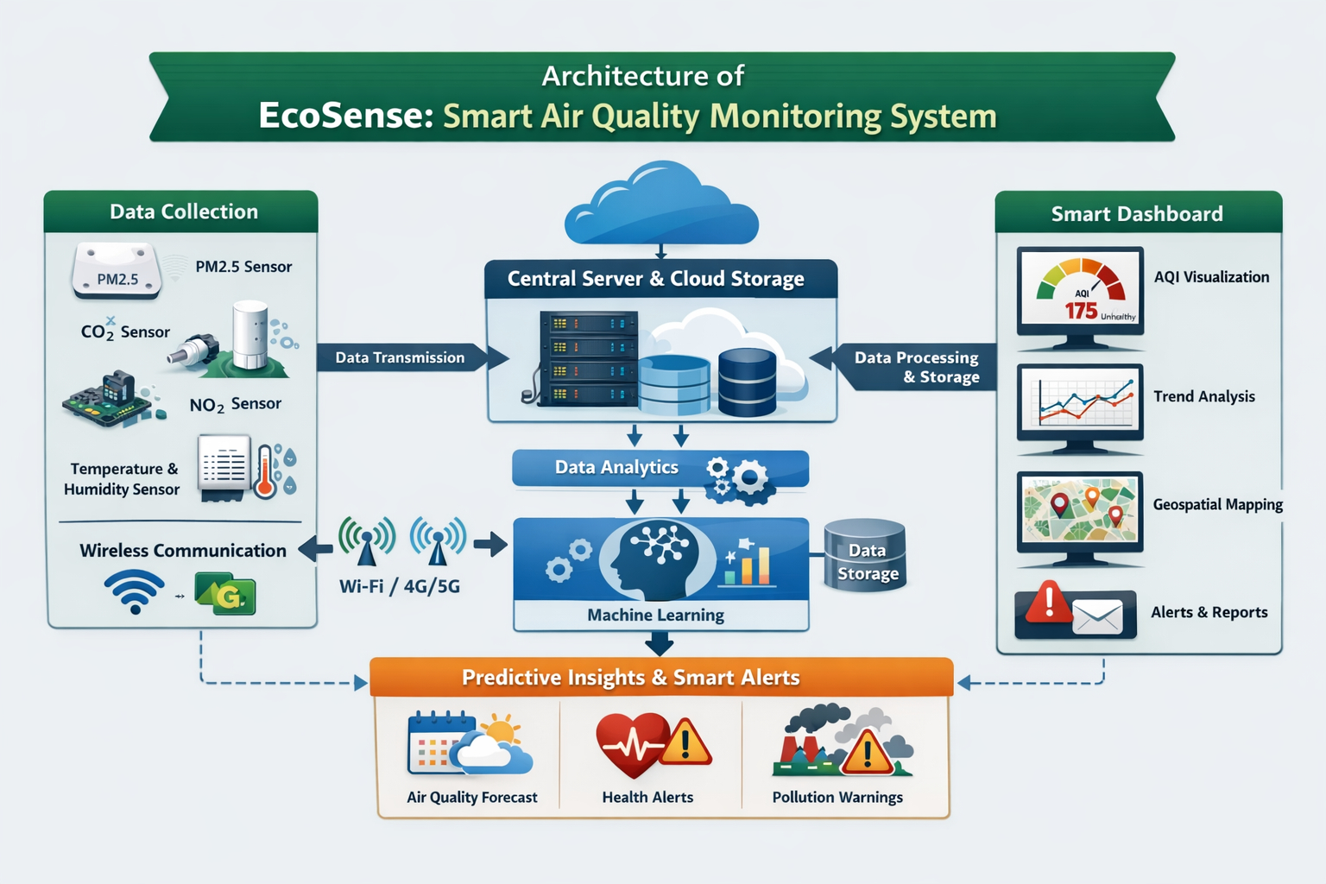
Architecture

Slide 8
Module-1: Air Quality Overview & Pollutant Distribution
Module 1 provides a real-time overview of air quality using AQI data across selected countries and date ranges.
Users can filter data by date and country to monitor pollution levels interactively.
The dashboard highlights smart alerts when AQI exceeds 200, indicating hazardous conditions.
Pollutant severity is categorized (Poor, Severe, etc.) for quick risk identification.
A structured data table displays country-wise AQI values for clear comparison.
This module enables early detection of high pollution zones for faster response and awareness.

Slide 9
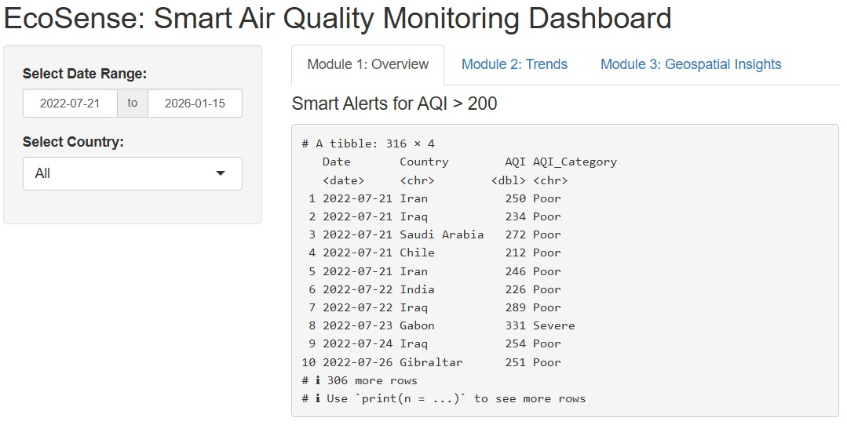
Output

Slide 10
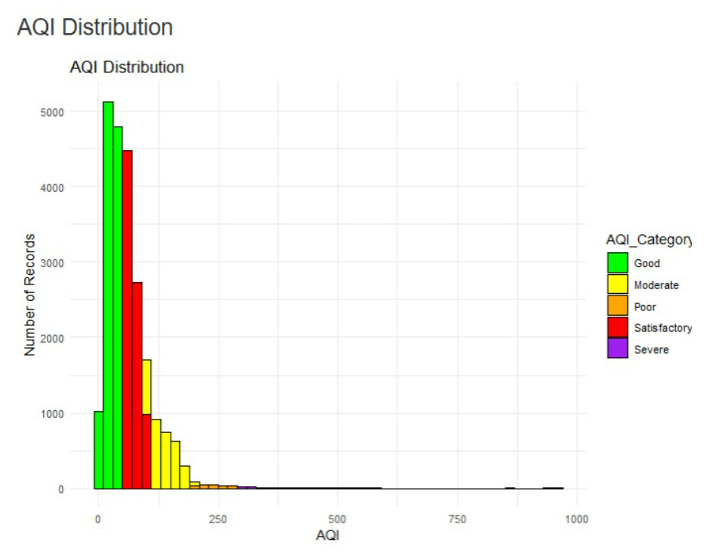
Output

Slide 11
Module-2:Trends and Relationships
Module 2 visualizes AQI trends over time using an interactive time-series chart.
It shows how air quality changes across months and years within the selected date range.
Pollutant severity is color-coded (Good to Severe) for easy trend comparison.
The graph helps identify spikes, seasonal patterns, and long-term pollution behavior.
Users can filter by country to study region-specific trends.
This module supports understanding relationships between pollution levels and time-based patterns.

Slide 12
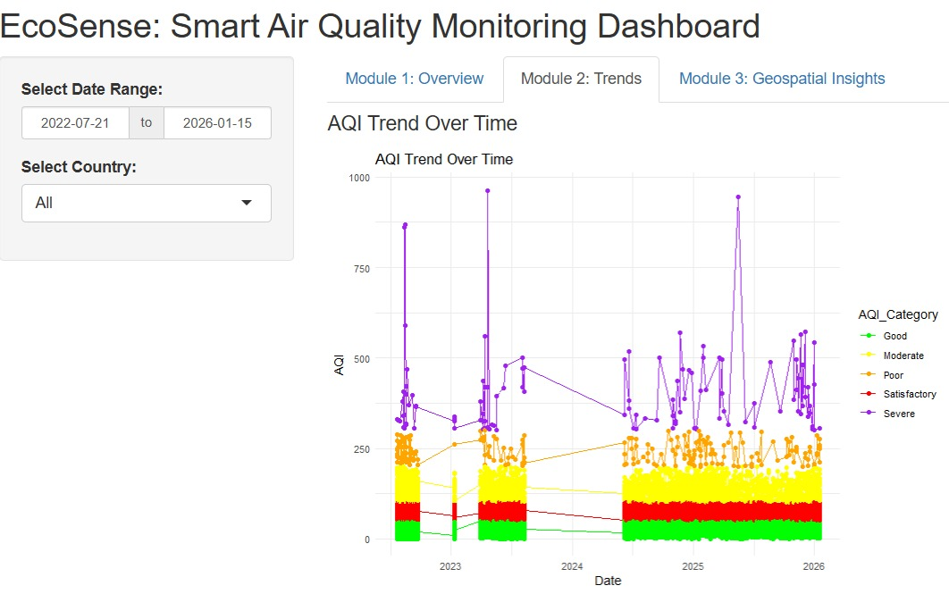
Output

Slide 13
Module-3: Geospatial and Smart Insights
Module 3 displays air quality data on an interactive geographic map.
Pollution levels are represented using color-coded markers across regions.
The map helps identify pollution hotspots and safer zones instantly.
Users can zoom and explore location-based AQI variations.
Smart visualization supports quick environmental risk assessment.
This module enables data-driven decisions for urban and regional planning.

Slide 14
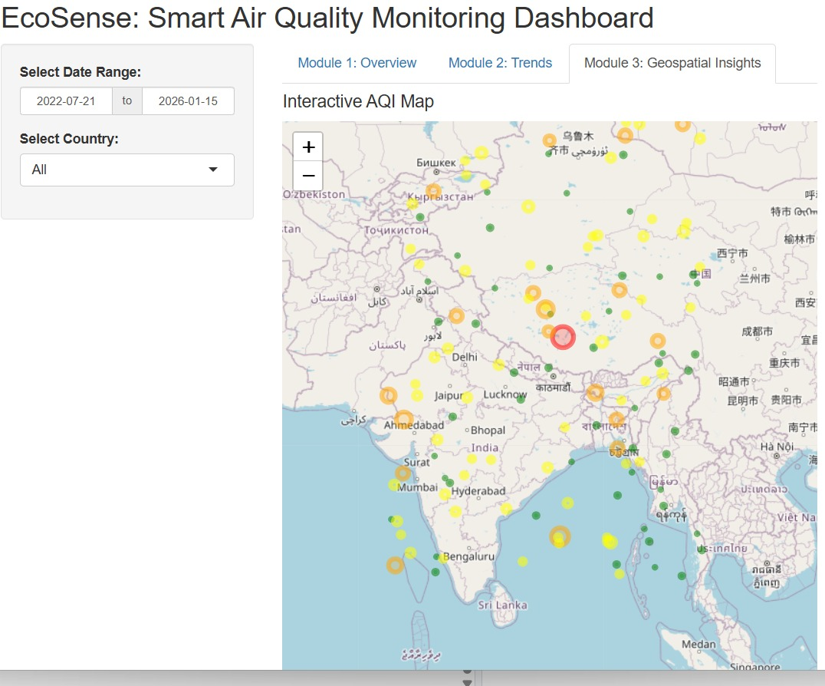
Output

Slide 15
Future prediction
Using EcoSense, the system can predict:
Future AQI Levels: Forecast daily or weekly air quality conditions for specific locations.
High-Risk Pollution Periods: Identify upcoming days or seasons with severe pollution.
Pollution Hotspots: Predict which regions are likely to become high-pollution zones.
Health Risk Alerts: Warn sensitive groups before pollution reaches hazardous levels.
Environmental Trends: Long-term predictions showing whether air quality is improving or degrading.

Slide 16
Challenges and Limitations
Sensor Accuracy & Calibration: Low-cost sensors may give imprecise readings and require frequent calibration to maintain reliability.
Data Connectivity & Transmission: Real-time monitoring depends on stable networks, and remote sensors may face data loss or battery issues.
Scalability & Maintenance: Expanding the system across large areas is costly and requires regular upkeep of multiple devices.
Data Interpretation & Visualization: Raw air quality data can be complex, and users may misinterpret it without clear, actionable dashboards.
Environmental & External Factors: Weather, pollution spikes, or improper sensor placement can affect data quality and reliability.

Slide 17
Future Scope
Integration with Smart Cities: Can be expanded to monitor air quality city-wide, linked with traffic, industrial, and weather systems for better urban planning.
Predictive Analytics: Using AI/ML to forecast pollution levels and alert citizens in advance.
Health Impact Monitoring: Linking air quality data with health apps to warn sensitive individuals (e.g., asthma patients) in real-time.
IoT and Automation: Automatic control of air purifiers, ventilation, or traffic flow based on air quality readings.
Global & Environmental Research: Data can support climate research, pollution studies, and policy-making for environmental protection.

Slide 18
Conclusion
Real-time Awareness: Provides instant insights into air quality for individuals and communities.
Informed Decision-Making: Helps policymakers and citizens take action to reduce pollution exposure.
Health & Safety Impact: Supports public health by alerting sensitive groups to hazardous air conditions.
Future-ready Platform: Can integrate AI, IoT, and predictive analytics for smarter environmental management.
Sustainability Contribution: Aids in creating cleaner, healthier, and more sustainable urban environments.

Slide 19
References
Zhao, X., et al., 2020. Development of IoT Technologies for Air Pollution Prevention and Improvement. Aerosol and Air Quality Research, 20(5), pp. 255–270.
Arkhan, R. & Elsi, 2024. Air Quality Monitoring System Based on Internet of Things. Journal of IoT and Smart Systems, 12(3), pp. 45–58.
Udit Narayan Das, 2024. Air Quality Monitoring Systems: Technologies, Trends, and Future Directions. International Journal of Civil Engineering Research, 15(6), pp. 100–112.
Advancing Air Quality Monitoring: A Low-Cost Sensor Network in Motion – Part I, 2024. Science of the Total Environment, 832, 155–167.
Springer Review, 2025. Advancements in Air Quality Monitoring: IoT and AI Integration. Artificial Intelligence Review, 58(4), pp. 1125–1145.

Slide 20
THANK
YOU!

